Slide 1
1 Planed
Planed 1
Watch the video slips for 10 to 24.
4

Slide 2
1 Results
Results 1
Yes ! I finished my plan.
4

Slide 3
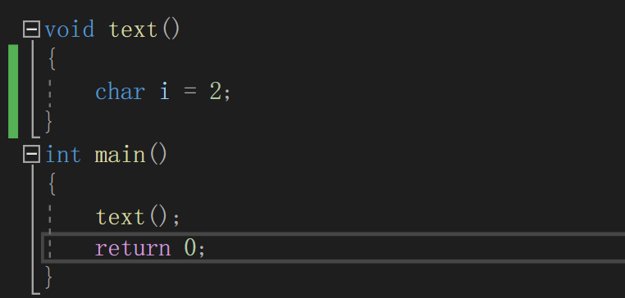
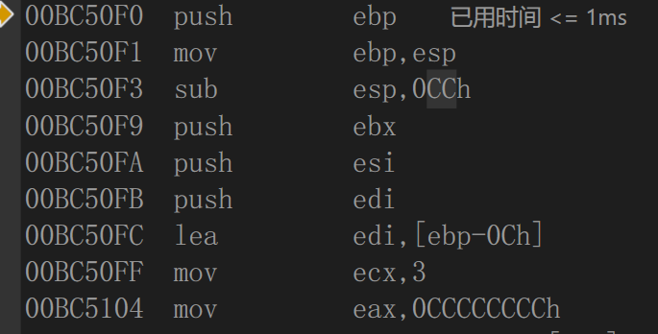
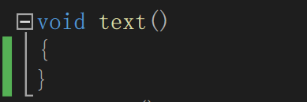
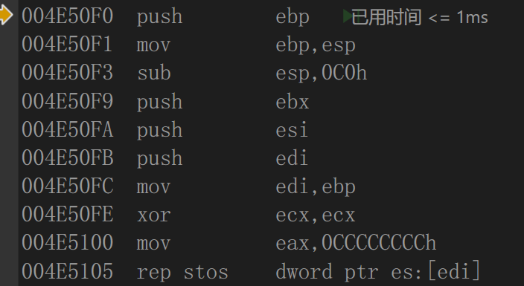
1 Challenges and Solutions
Challenges and solutions 1
Please look at the screenshot , after I write the code `char i = 2` , the size of this function’s buffer goes from `C0` to `CC`. But the size of `char` is one byte , what causes this change.不同的编译器有不同，我看滴水三期的那个课里，实验用的是vc6和我的就不一样。
4

Slide 4
1 Plan
plan 1
Two slips a day, this week from 25 to 38.
These slips are about pointer in C and the file operation.
4

Slide 5
2 Plan
plan 2
My school offers a course called TOEFL tutoring class , every student can attend it if interested in . I plan to have a try.
These days I found that my English is too bad.😔
4

